Slide 1


`
Schulich School of Business MMAI 5090
Week 2 : Classification metrics and Naive Bayes Classifier
Business applications of artificial intelligence II
Instructor: Boris Garbuzov
MMAI 5090
Summer 2021
SCHULICH SCHOOL OF BUSINESS | MMAI 5090
MODULE 1
Business applications of artificial intelligence II
2020

Slide 2
Agenda
Learning function
Classifiers
Classification metrics
Bayesian classifier
No predictors case
One and two predictors
Ideal Bayesian classification rate
Estimation of probabilities
Conditional independence. Naive Bayes
Python implementation
Questions and discussion
2 / 30

Slide 3
Classification Problems
Here the response variable Y is qualitative — e.g. email is one of C = (spam, ham) (ham=good email), digit class is one of C = {0, 1, . . . , 9}. Our goals are to:
Build a classifier C(X) that assigns a class label from C to a future unlabeled observation X.
Assess the uncertainty in each classification
Understand the roles of the different predictors among
X = (X₁, X₂, . . . , X_{p}).
3 / 30

Slide 4
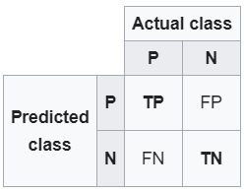


TPR & FNR
TPR
FNR
<complement>

Slide 5
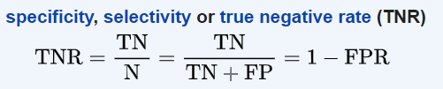

TNR & FPR
TNR
FPR
<complement>

Slide 6


PPV & FDR
PPV
FDR
<complement>

Slide 7


NPV & FOR
NPV
FOR
<complement>

Slide 8

Accuracy
More interpretable metric, but useless on unbalanced sets
Accuracy

Slide 9


F₁ score
Is the harmonic mean of precision and recall metrics. It is also named as Dice similarity coefficient, DSC or Sørensen index
Identically to

Slide 10
Types of errors
False positive rate: The fraction of negative examples that are classified as positive — 0.2% in example.
False negative rate: The fraction of positive examples that are classified as negative — 75.7% in example.
We produced this table by classifying to class Yes if
(Default = Yes|Balance, Student) ≥ 0.5
We can change the two error rates by changing the threshold from 0.5 to some other value in [0, 1]:
(Default = Yes|Balance, Student) ≥ threshold,
and vary threshold.

Slide 11
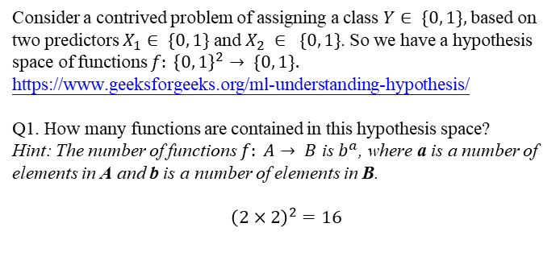
Classification metrics. Example
Consider a contrived problem of assigning a class $Y∈ \{0, 1\},$based on two predictors $X_{1}∈ \{0, 1\}$and $X_{2} ∈ \{0, 1\}$. So we have a hypothesis space of functions $f: {\left\{0, 1\right\}}^{2}→ \{0, 1\}.$
https://www.geeksforgeeks.org/ml-understanding-hypothesis/
Q1. How many functions are contained in this hypothesis space?
Hint: The number of functions $f: A→ B$ is $b^{a}$, where a is a number of elements in A and b is a number of elements in B.
$${\left(2×2\right)}^{2}=16$$

Slide 12
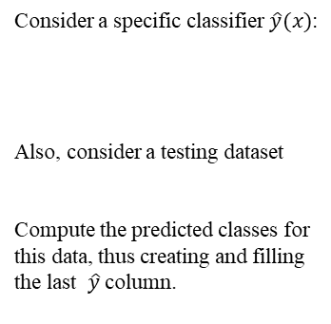
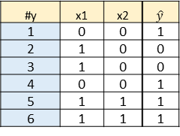
Classification metrics. Example
Consider a specific classifier $\hat{y}(x)$:
Also, consider a testing dataset
Compute the predicted classes for this data, thus creating and filling the last $\hat{y}$column.
# | x1 | x2 | yHat
1 | 0 | 0 | 1
2 | 0 | 1 | 1
3 | 1 | 0 | 0
4 | 1 | 1 | 1
#y | x1 | x2 | $$\hat{y}$$
1 | 0 | 0 | 1
2 | 1 | 0 | 0
3 | 1 | 0 | 0
4 | 0 | 0 | 1
5 | 1 | 1 | 1
6 | 1 | 1 | 1

Slide 13

Classification metrics. Example
Now the true classes of our dataset become known. Thus, we have the new y column:
Traditionally, consider 0 to be a negative class, while 1 be a positive class. Putting together your y and $\hat{y}$ columns, label each line and TP, TN, FP, FN in a new column that you call label.
# | x1 | x2 | y
1 | 0 | 0 | 1
2 | 1 | 0 | 1
3 | 1 | 0 | 0
4 | 0 | 0 | 1
5 | 1 | 1 | 1
6 | 1 | 1 | 1

Slide 14
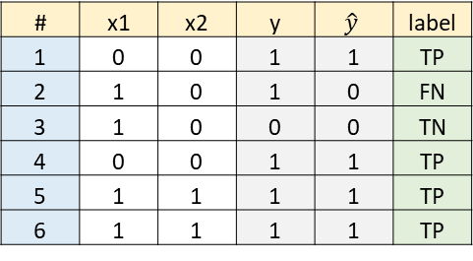
Classification metrics. Example
# | x1 | x2 | y | $$\hat{y}$$ | label
1 | 0 | 0 | 1 | 1 | TP
2 | 1 | 0 | 1 | 0 | FN
3 | 1 | 0 | 0 | 0 | TN
4 | 0 | 0 | 1 | 1 | TP
5 | 1 | 1 | 1 | 1 | TP
6 | 1 | 1 | 1 | 1 | TP

Slide 15
Classification metrics. Example
The label column in the previous question may be considered as data for the confusion matrix in a tall format. Now, count the labels and put them into a new format, thus creating the actual confusion matrix.
Compute the margins of the table in the previous questions, thus computing
(Condition N) = (N) = (number of actual Y=0) = (TN + FP)= 1+0=1
(Condition P) = (P) = (number of actual Y=1) = (FN + TP)= 1+4=5
(Predicted N) = (number of predicted Y=0) = (TN + FN)=1+1=2
(Predicted P) = (number of predicted Y=1) = (FP + TP)=0+4=4
Actual Y \ Predicted Y | Predicted 0 | Predicted 1
Actual or condition 0 | 1 | 0
Actual or condition 1 | 1 | 4

Slide 16
Classification metrics. Example
Sensitivity (recall, hit rate or true positive rate TPR) =TP/P = 4/5 = 0.8
In this case frequencies of both classes are quite similar. Comment on applicability of the metric in the previous question in case when one class is much more frequent than the other.
Specificity (selectivity or true negative rate TNR) = TN/N = 1/1 = 1
Note, this metric is not implemented in sklearn.
Precision (or positive predictive value PPV) = TP/(TP+FP)= 4/(4+0)=1
Accuracy = (TP+TN)/(P+N) = (4+1)/(4+2)= 5/6 = 0.8333

Slide 17
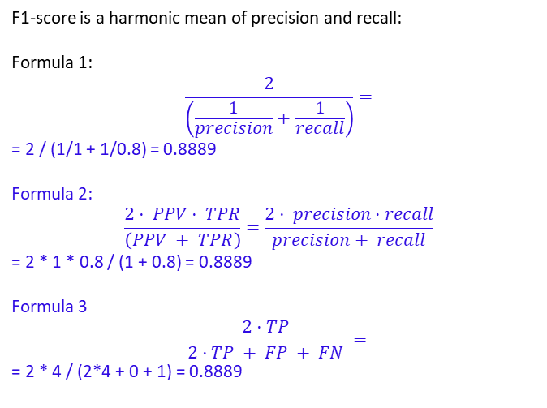
Classification metrics. Example
F1-score is a harmonic mean of precision and recall:
Formula 1:
$$\frac{2}{\left(\frac{1}{precision}+\frac{1}{recall}\right)}=$$
= 2 / (1/1 + 1/0.8) = 0.8889
Formula 2:
$$\frac{2⋅ PPV⋅ TPR}{\left(PPV + TPR\right)}=\frac{2⋅ precision⋅recall}{precision+ recall}$$
= 2 * 1 * 0.8 / (1 + 0.8) = 0.8889
Formula 3
$$\frac{2⋅TP}{2⋅TP + FP + FN} =$$
= 2 * 4 / (2*4 + 0 + 1) = 0.8889

Slide 18
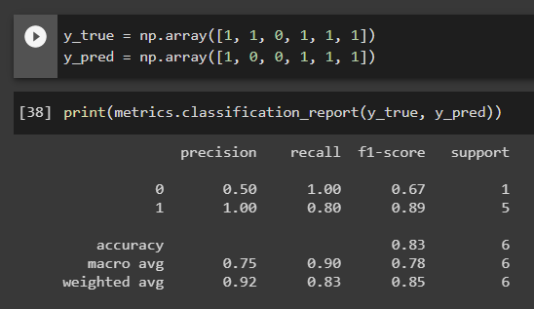
Classification metrics. Example
In Python, consider classification report, corresponding to this example. Some of these metrics we already computed. The other parts of it we will compute now step by step.

Slide 19
Classification metrics. Example
If initially we computed precision with default class to be positive, now, according to above classification report, we need to compute class-wise precision:
precision(0) (or negative predictive value NPV)=TN/(TN+FN)= 1/(1+1)=0.5
precision(1) (or positive predictive value PPV) = TP/(TP+FP)= 4/(4+0)=1
The Python classification report contains its macro average =
= (precision(0) + precision(1))/2 = (0.5 + 1)/2 = 0.75
As you could see, the classification report contains the rightmost support column. It contains absolute prior frequencies of classes. Compute
support_0 = number of points that actually belong to class 0 =1 + 0 = 1
and
support_1 = number of points that actually belong to class 1 = 1 + 4 = 5
Compute the full support = support_0 + support_1= 1+5 = 6

Slide 20
Classification metrics. Example
Compute class prior relative frequencies that will be used as weights for further averaging.
weight_0 = support_0 / support = 1/6 = 0.1667
weight_1 = support_1 / support = 5/6 = 0.8333
Check weight_0 + weight_1 = 0.1667 + 0.8333 = 1
The bottom row of the classification report contains weighted averages of the metrics. They use the weights that we already computed.
Compute the weighted precision = weight_0 * precision_0 + weight_1 * precision_1=0.1667*0.5 + 0.8333*1 = 0.9167

Slide 21
Classification metrics. Example
Before we computed recall in its default sense as sensitivity, hit rate or true positive rate TPR =TP/P. Now we call that quantity recall_1, and we also need recall_0. We write both:
recall_0 = TN/N = 1/1 = 1
recall_1 = TP/P = 4/5 = 0.8
Now compute their arithmetic mean, called macro average in Python's classification report
macro avg recall = (recall_0 + recall_1) / 2= (1 + 0.8) / 2 = 0.9
Also we compute the weighted average recall = weight_0 * recall_0 + weight_1 * recall_1= 0.1667*1 + 0.8333*0.8 = 0.8333

Slide 22
Classification metrics. Example
Before we computed f1-score as a harmonic mean of precision and recall. Now we say, it was a default f1-score with respect to class 1, and we also want its class 0 counterpart. Write both
f1_0 = 2 / (1/precision_0 + 1/recall_0) = 2 / (1/0.5 + 1/1) = 0.6667
f1_1 = 2 / (1/precision_1 + 1/recall_1) = 2 / (1/1 + 1/0.8) = 0.8889
Now compute their arithmetic mean, called macro average in Python's classification report:
macro avg f1 = (f1_0 + f1_1) / 2 = (0.67+0.89)/2 = 0.78
Now compute f1 weighted average, listed in the botton line of Python's classification report:
weighted avg f1 = w_0*f1_0 + w_1*f1_1 = 1/6*0.67 + 5/6*0.89 = 0.8533

Slide 23
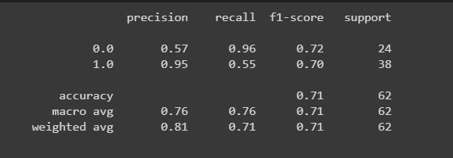

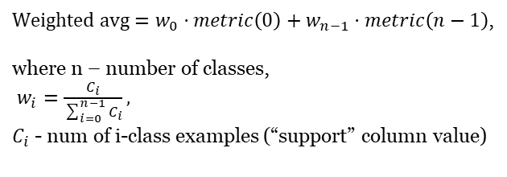
Classification report
Macro avg = $\frac{metric\left(0\right)+…+metric\left(n−1\right)}{n}$,
$Weighted avg=w_{0}⋅metric\left(0\right)+w_{n−1}⋅metric\left(n−1\right)$,
where n – number of classes,
$w_{i}=\frac{C_{i}}{\sum_{i=0}^{n−1}{C_{i}}},$
$C_{i}$ - num of i-class examples (“support” column value)

Slide 24
Bayes classifier

Slide 25
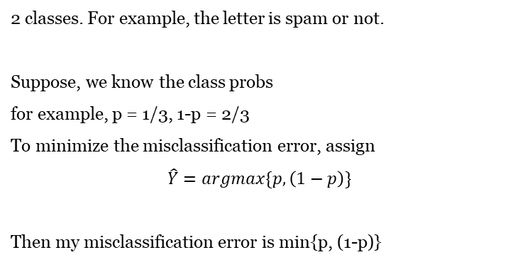
Ideal prior
p | 1-p

Slide 26
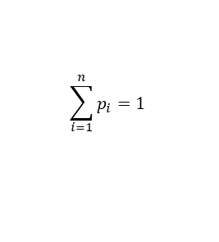
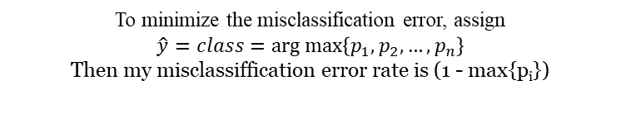
Ideal prior classifier
Class | C₁ | C₂ | … | C_{n}
Probability | p₁ | p₂ | … | p_{n}

Slide 27

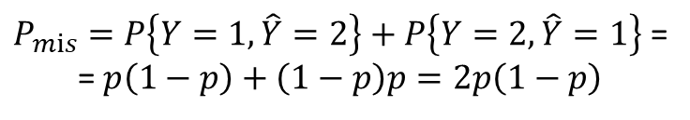
Ideal prior
Let us compare this choice to another tempting solution to randomize my decision independently, assigning
{
1, p
2, 1-p
Here p is the same true known P{Y=1}.
Then the probability of misclassification

Slide 28

Ideal prior
determinstic ≤ randomized
0
1
p
Since there is no x, the posterior probability is just prior

Slide 29

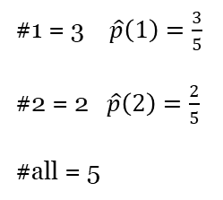
Estimating prior probabilities
1
1
2
2
1

Slide 30
Ideal Bayes
Bayes classifier on Wiki
Probability space
Suppose, as before, we have 2 classes, and X predictor with 2 values. For example, presence of the word "free" in the letter. The minimal settings for Bayes classifier. Let the prior distribution of Y be given as before.
y₂
Ω
y₁
x
x₁
x₂
π₁=p | π₂=1-p
Let the conditional probabilities be given on top of it

Slide 31
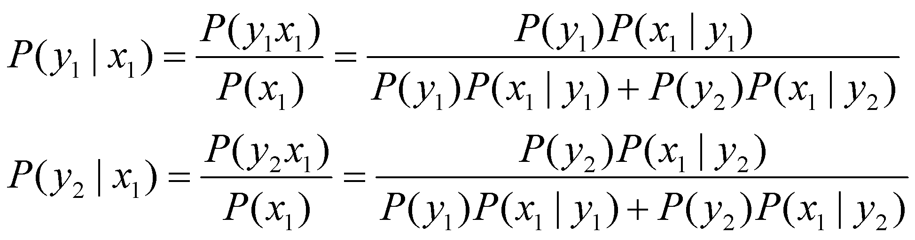
Ideal Bayes
Y\X | x₁ | x₂
y₁ | P(X=x₁|Y=y₁) | P(x₂|y₁)
y₂ | P(x₁|y₂) | P(x₂|y₂)
In fact, only half should be given.
P(x₂|y₁)=1-P(x₁|y₁)
P(x₂|y₂)=1-P(x₁|y₂)
Then the posterior probabilities can be computed by Bayes's theorem
Same denominator. Compare two numerators

Slide 32

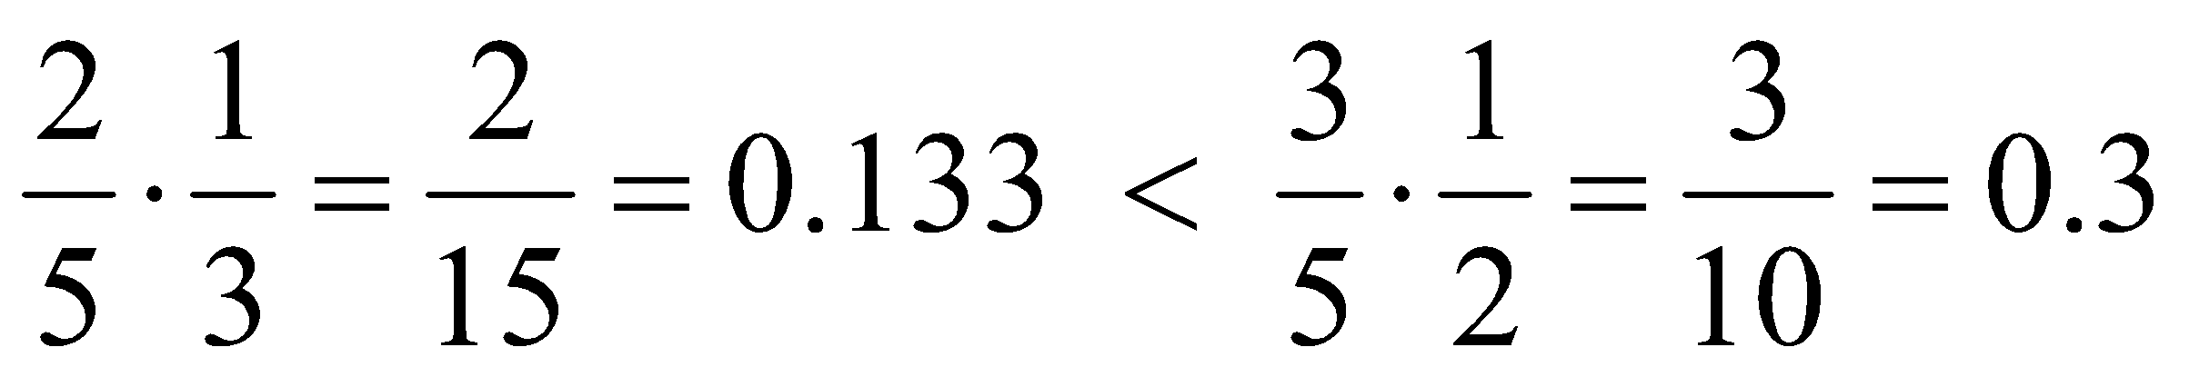










Ideal Bayes
Choose max
Y\X | x₁ | x₂
y₁ | P(X=x₁|Y=y₁) | P(x₂|y₁)
y₂ | P(x₁|y₂) | P(x₂|y₂)
So I choose y_{2,} and my prediction is
Therefore, X is not a useful predictor. It does not discriminate Y. And our misclassification probability, for this distribution,
as before is just a minimal of two prior values = 2/5

Slide 33





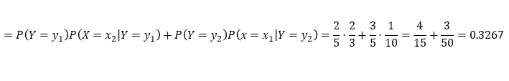
Ideal Bayes
Take another example
x₁: 2/5 * 1/3 = 0,1333 : y₁
3/5 * 1/10 = 0,06 : y₂
So now we choose y₁, when X= x₁
Now for x₂: 2/5 * 2/3 = 0.2667 : y₁
3/5 * 9/10 = 0.54 : y₂
Here we keep our choice of y₂, and the Bayes classifier is
Y\X | x₁ | x₂
y₁ | P(X=x₁|Y=y₁) | P(x₂|y₁)
y₂ | P(x₁|y₂) | P(x₂|y₂)
{
And the misclassification error by disjoint additivity

Slide 34
Bayes Error Rate
The Bayes error rate refers to the lowest possible error rate that could be achieved if somehow we knew exactly what the “true” probability distribution of the data looked like.
On test data, no classifier (or stat. learning method) can get lower error rates than the Bayes error rate.
Of course in real life problems the Bayes error rate can’t be calculated exactly.
Bayes error rate on wilki

Slide 35
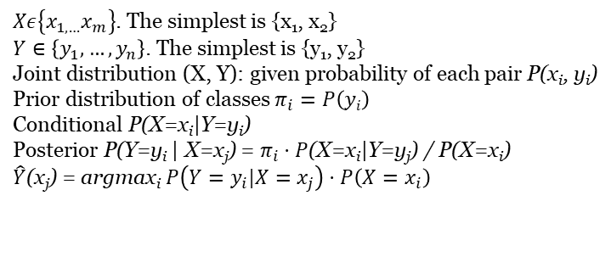
Ideal Bayes
What we did above is the best possible use of prior and conditional probabilities for classification. The proof is beyond the level of this course.
Ideal Bayes classifier

Slide 36


Estimating joint and conditional probabilities
Occurrences table
X
 | x₁ | x₁
y₁
y₂
Y
X
 | x₁ | x₂ | π_{i}
y₁
y₂
P(x_{i}) |  |  | 1
Y
3/8 + 0/8 + 4/8 + 1/8 = 1

Slide 37

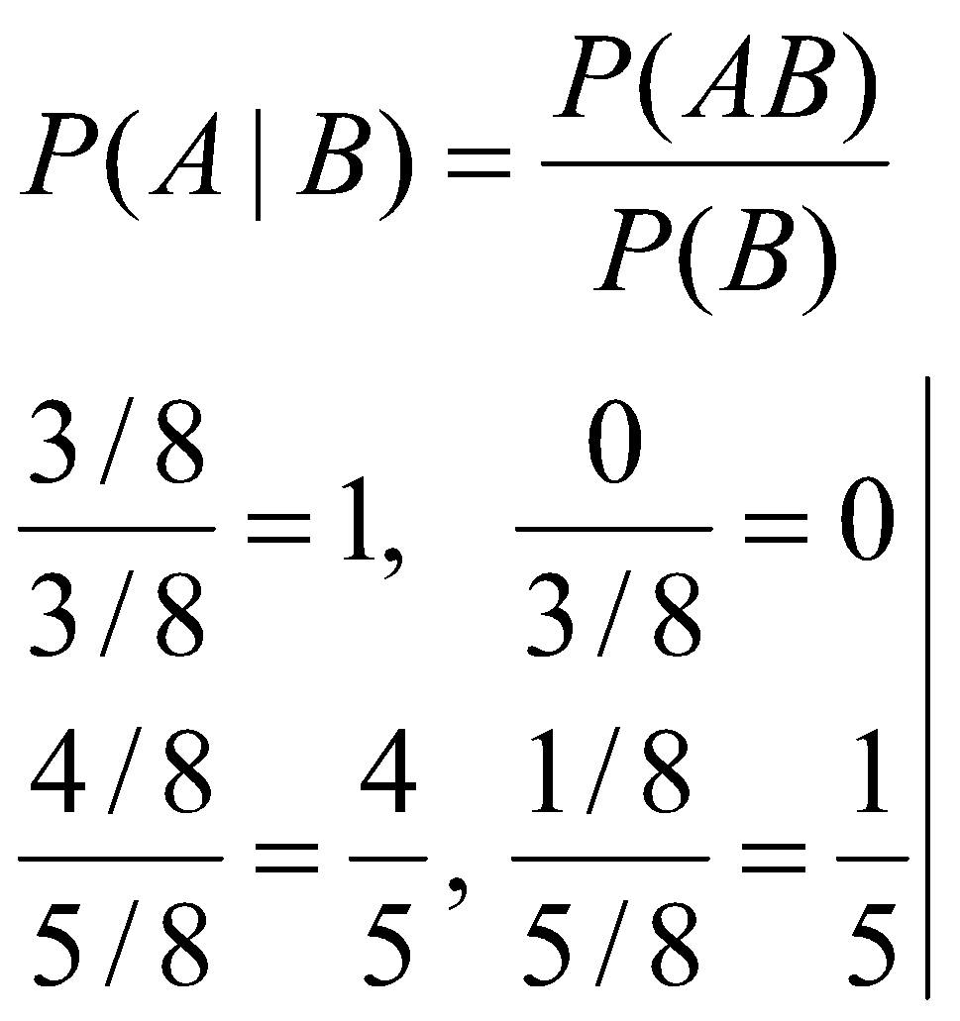
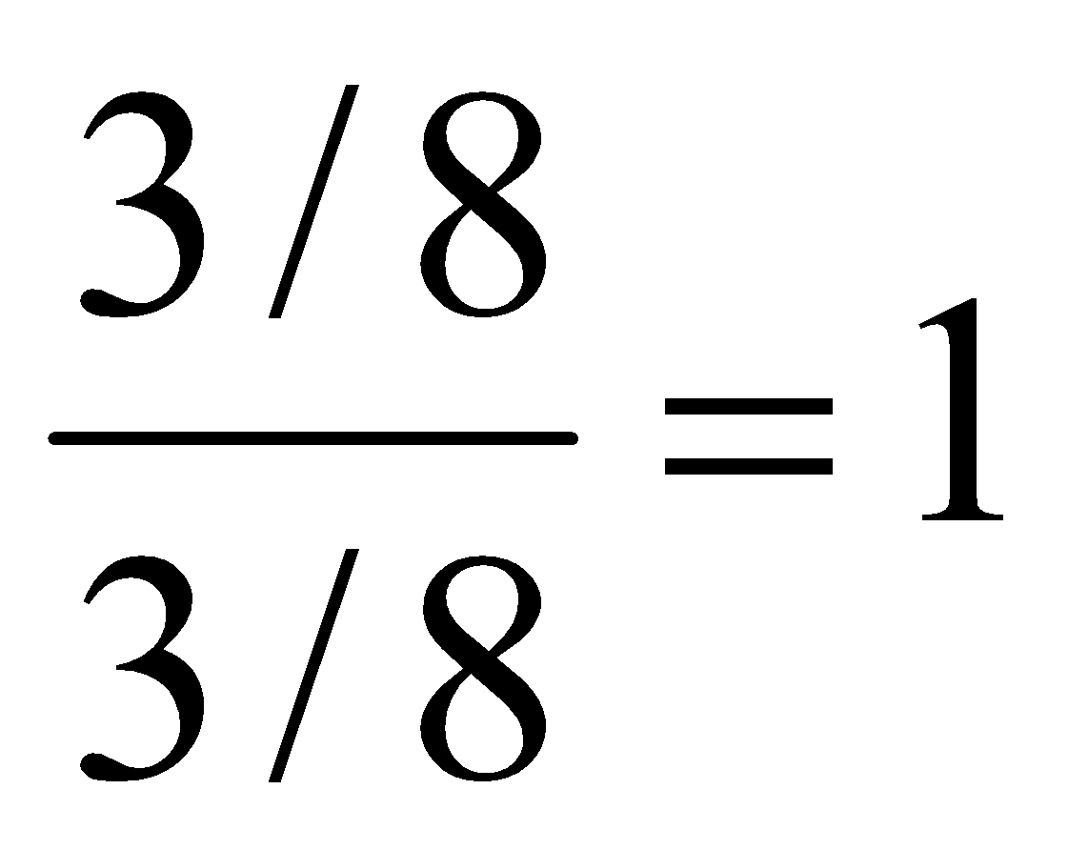
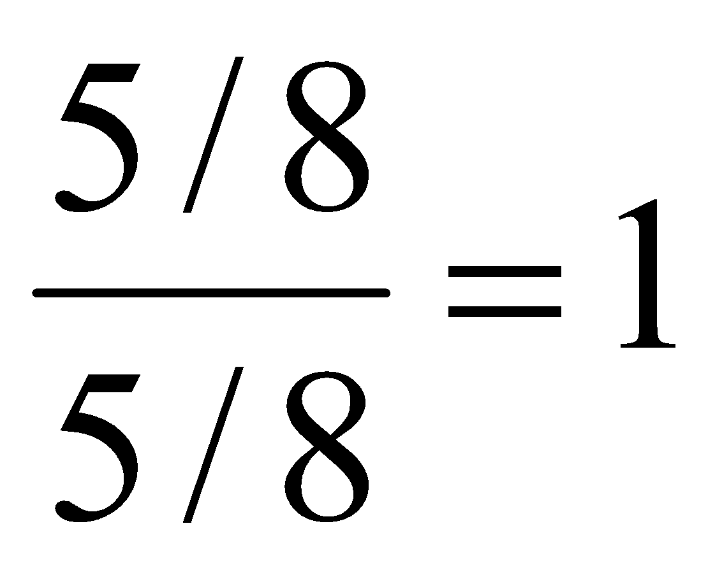
Estimating joint and conditional probabilities
Estimates of conditional probabilities
X
 | x₁ | x₂
y₁ | 1 | 0 | 1
y₂ | 4/5 | 1/5 | 1
Y
Full conditional probability of a subcase Y= y₂

Slide 38
Bayes classifier quiz practice
Suppose, one of the classifiers in A-D is Bayesian. If r is the classifier's error rate, which of the classifiers is Bayesian?
A: r = 0.14
B: r = 0.137
C: r = 0.13
D: r = 0.135

Slide 39
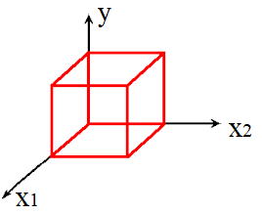
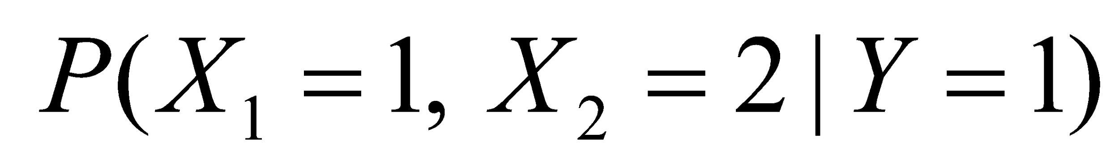
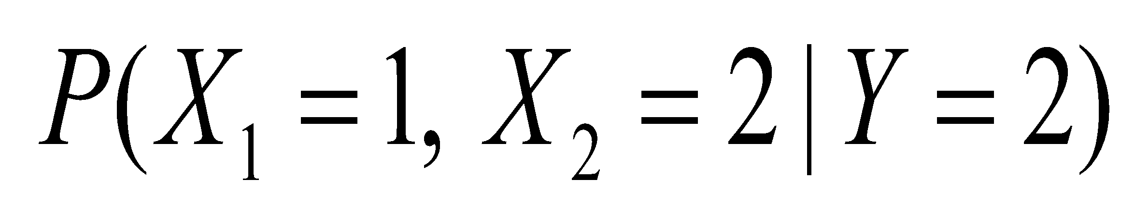
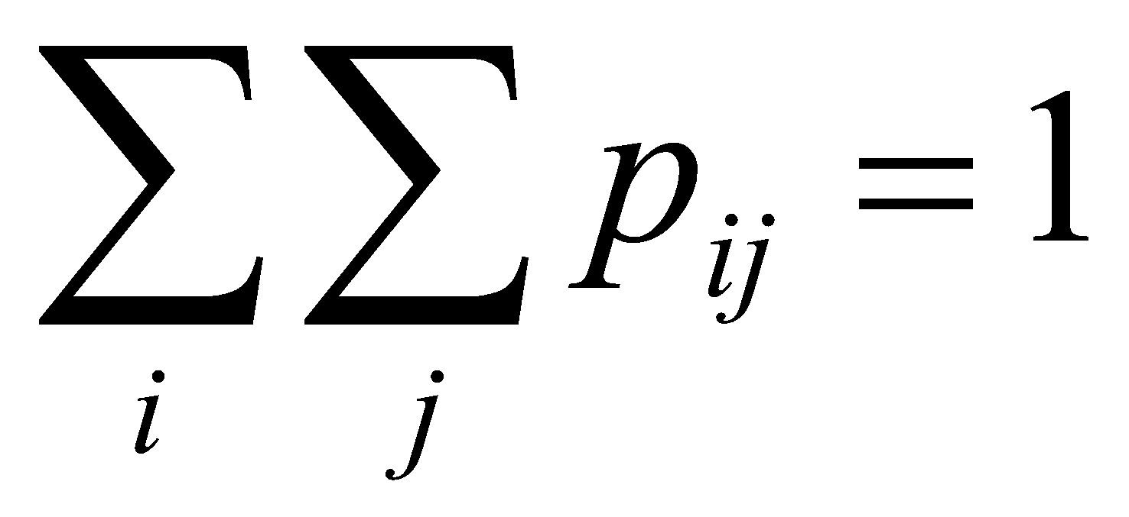
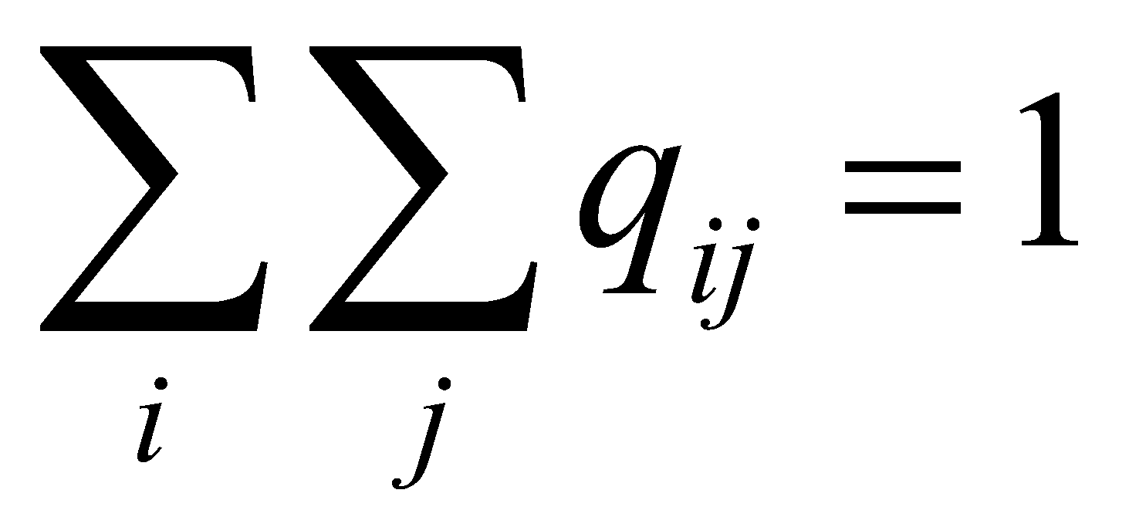
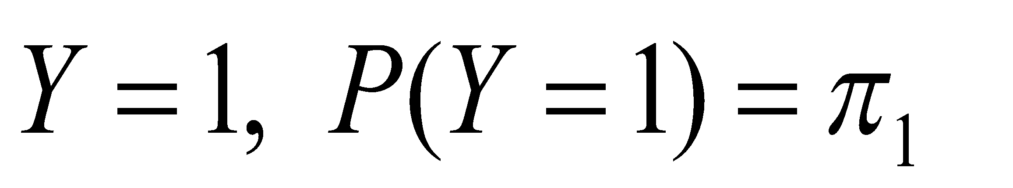
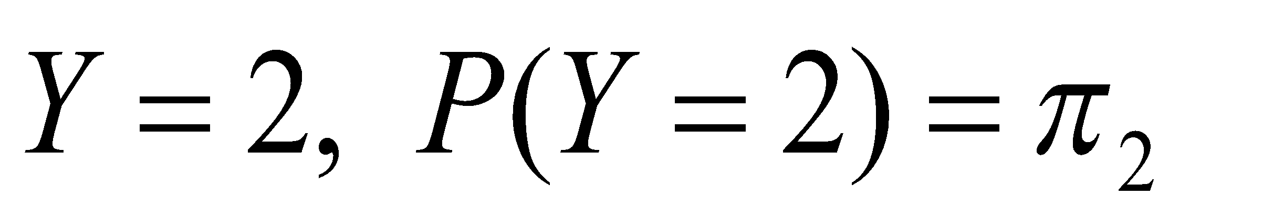
Two predictors
Joint distribution of 3 variables: X₁, X₂, Y
Again, we illustrate just the minimal case of 2 values each
Probability space of a size 2³ = 8
Use X₁, X₂ to predict Y
(X₁, X₂) -> Y
Tables of joint conditional
x₁
x₁
 | 1 | 2
1 | p₁₁ | p₁₂
2 | p₂₁ | p₂₂
 | 1 | 2
1 | q₁₁ | q₁₂
2 | q₂₁ | q₂₂
x₂
x₂

Slide 40

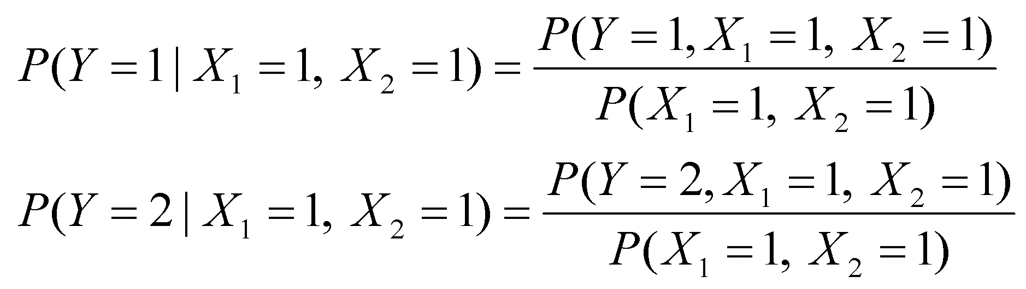
Two predictors
Suppose, we have our predictors X₁ = 1, X₂ = 1 What is the most precise prediction for Y? Again, we compute 2 posterior probabilities
and choose the larger. This will be an ideal Bayes classifier based on 2 predictors.
How to compute these posteriors? By Bayes formula.
Which one is bigger?
Both have the same denominator.
So we need to compare just numerators.

Slide 41
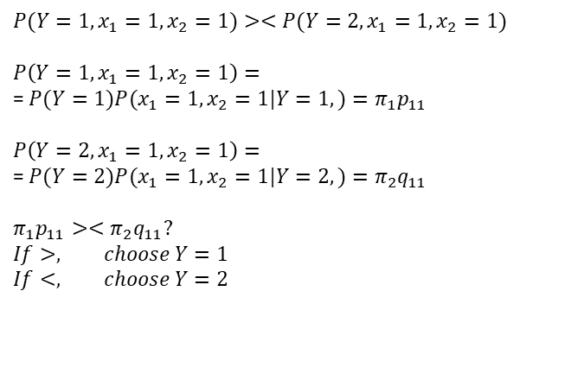
Two predictors

Slide 42
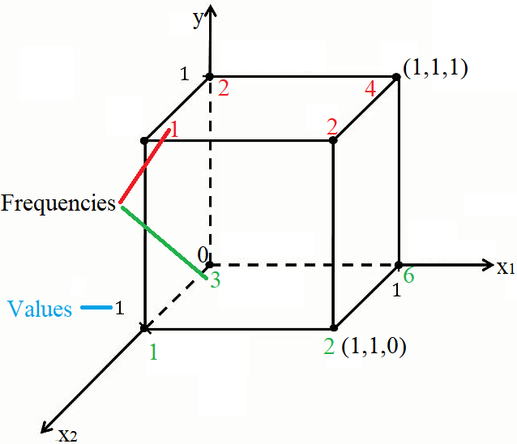
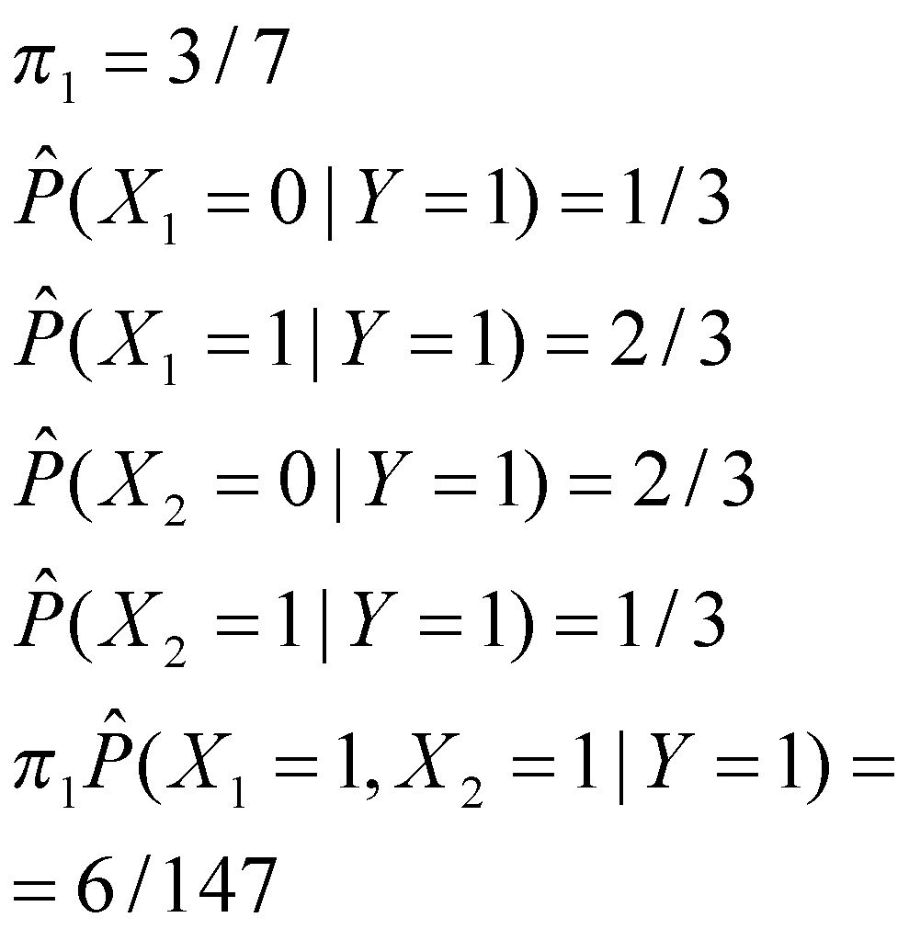
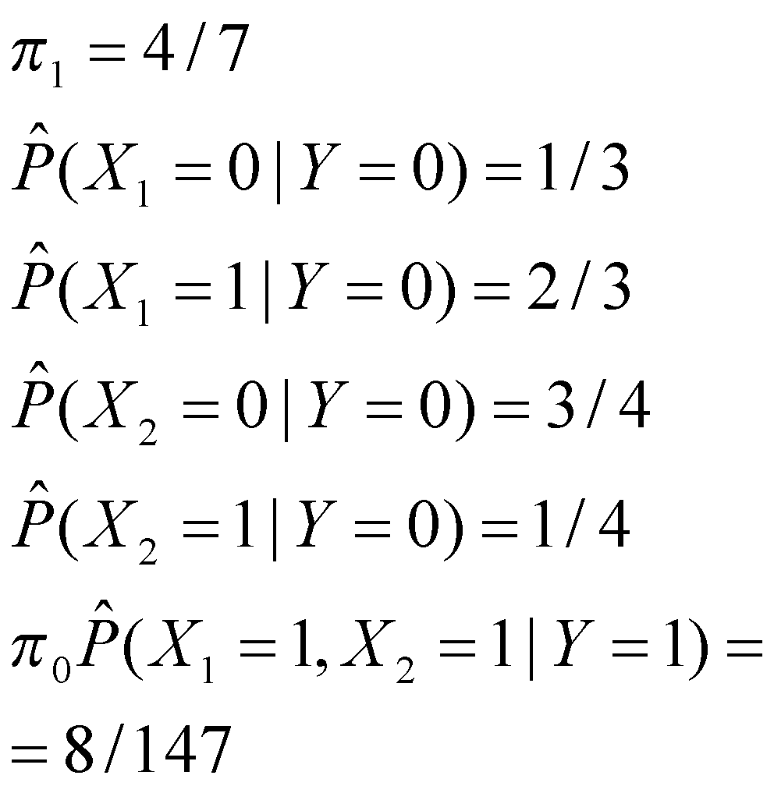
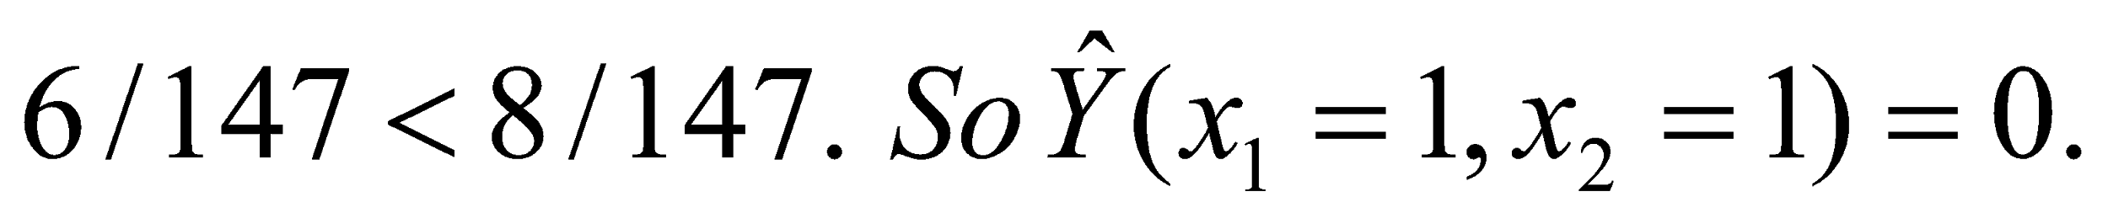
Fully estimated Bayes classifier example

Slide 43
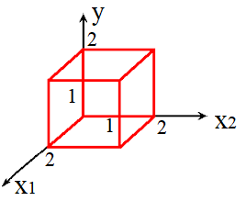
Conditional independence assumption
As, before, consider joint distribution of 3 variables: X₁, X₂, Y
Again, we illustrate just the minimal case of 2 values each
Probability space of a size 2³ = 8
Use X₁, X₂ to predict Y
x₁
dep
Cond. ind
Y
x₂
dep

Slide 44



Conditional independence assumption
But assume conditional independence of two predictors
This means, joint tables of X₁, X₂, conditioned on Y, contain products
x₂
 | p₂ | 1-p₂
p₁ | p₁p₂ | p₁ (1-p₂)
1-p₁ | (1-p₁)p₂ | (1-p₁) (1-p₂)
x₁

Slide 45
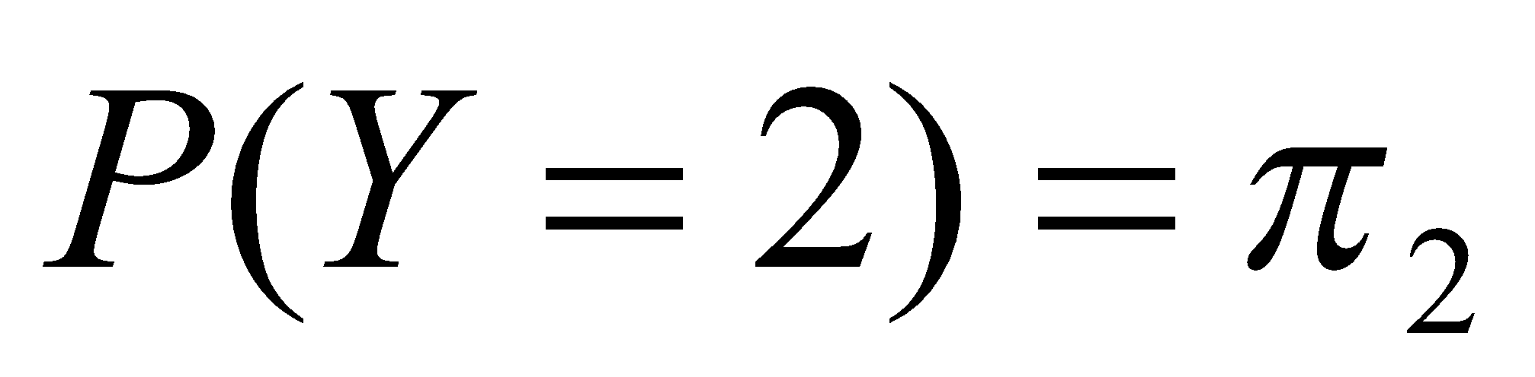
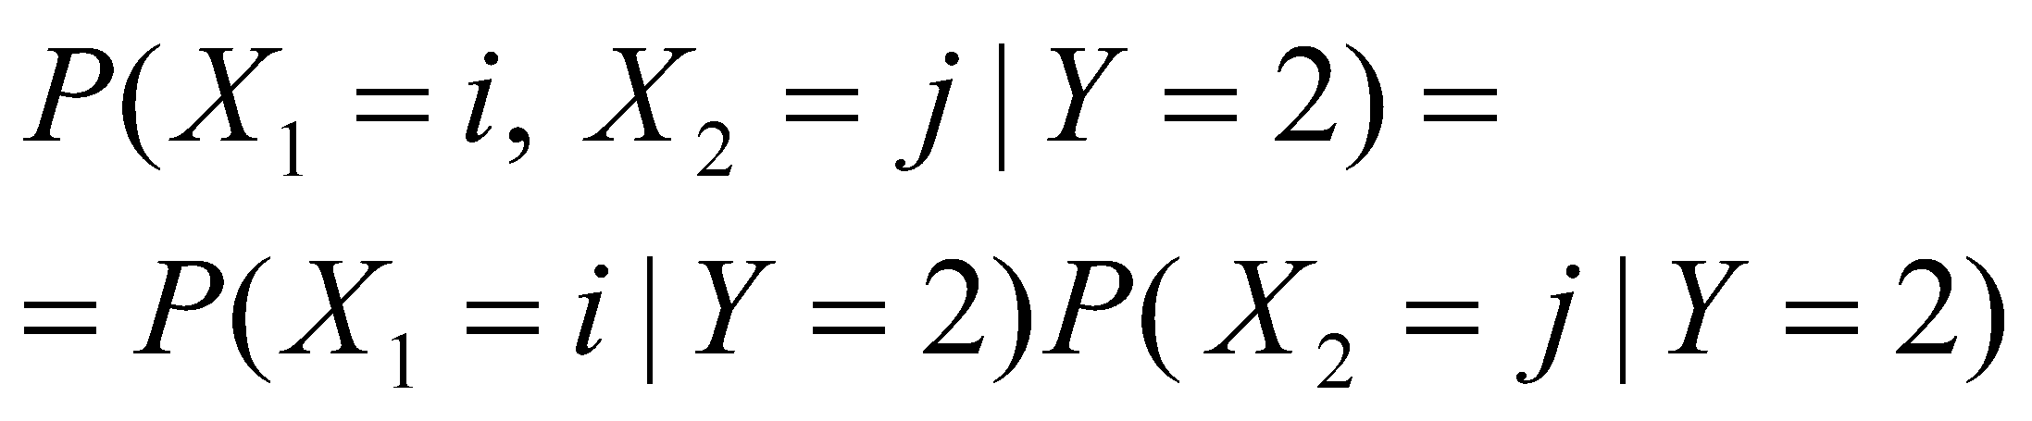
Conditional independence assumption
x₂
 | q₂ | 1-q₂
q₁ | q₁q₂ | q₁ (1-q₂)
1-q₁ | (1-q₁)q₂ | (1-q₁) (1-q₂)
x₁

Slide 46
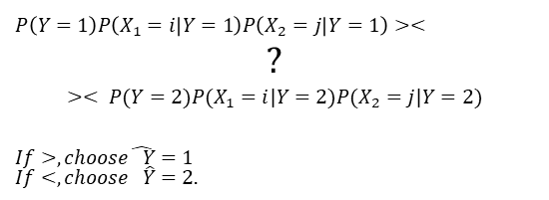
Conditional independence assumption
If our predictor pair is X₁=i, X₂=j .
How to make a decision on Y value? If all the above probabilities are given, we compare

Slide 47
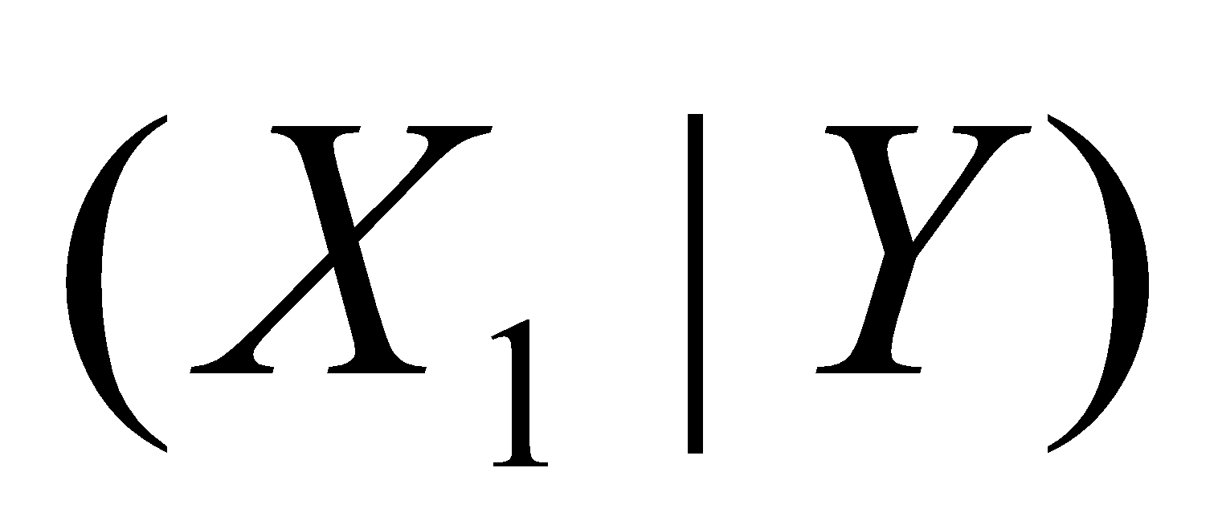
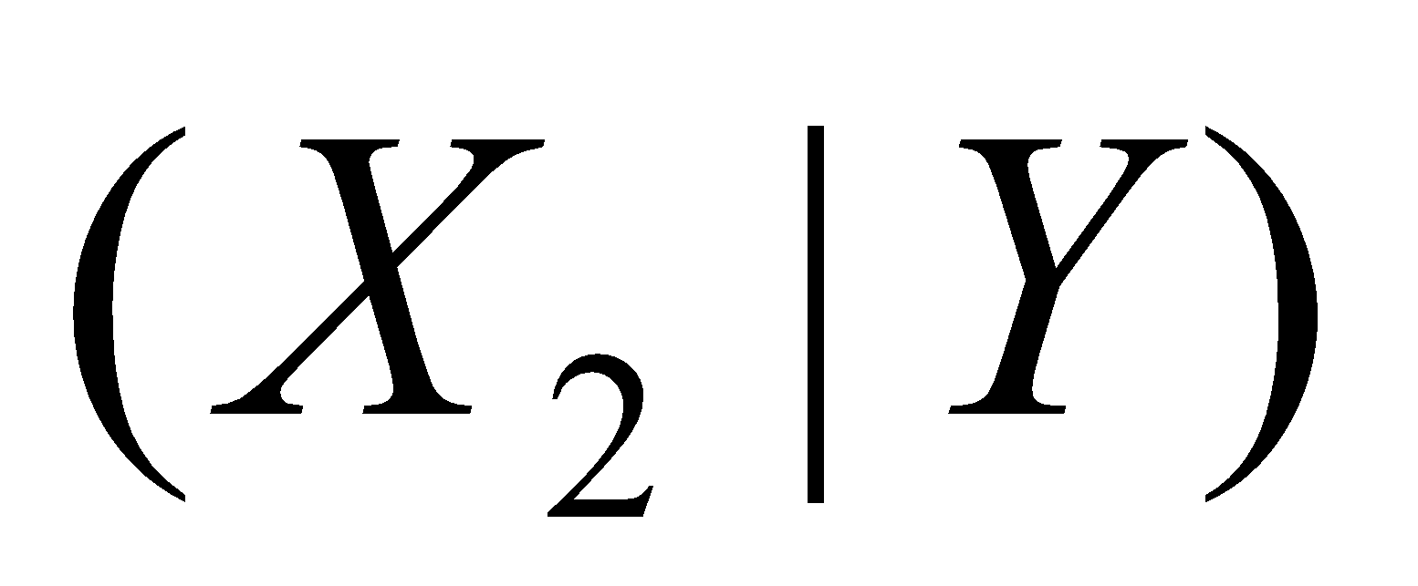
Joint estimation based on independence
We assume independence of X₁ and X₂, both conditioned on Y
||
In terms of joint conditional cdf
Assumption of independence is one of the ways to get rid of gaps
First compute the marginal frequencies

Slide 48
Joint estimation based on independence. Example
Suppose we have the same occurrences table as in the previous slide
x₂
x₂
 | 1 | 2
1
2
 | 1 | 2
1
2
x₁
x₁
3+0=3
4+1=5
Y=1
Y=1
3+4=7
0+1=1
7+1=3+5=8

Slide 49
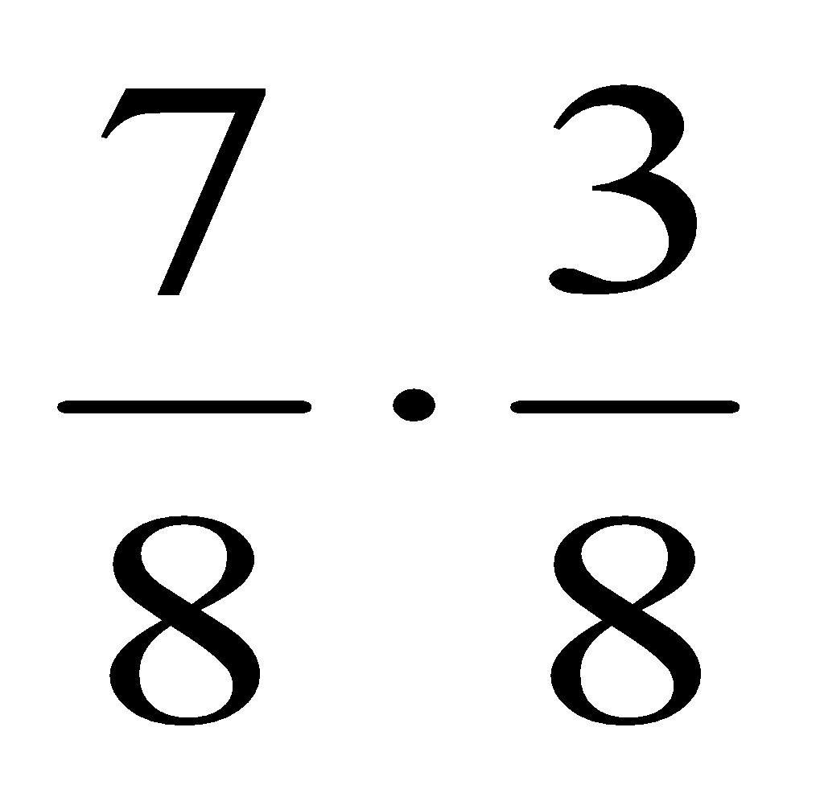
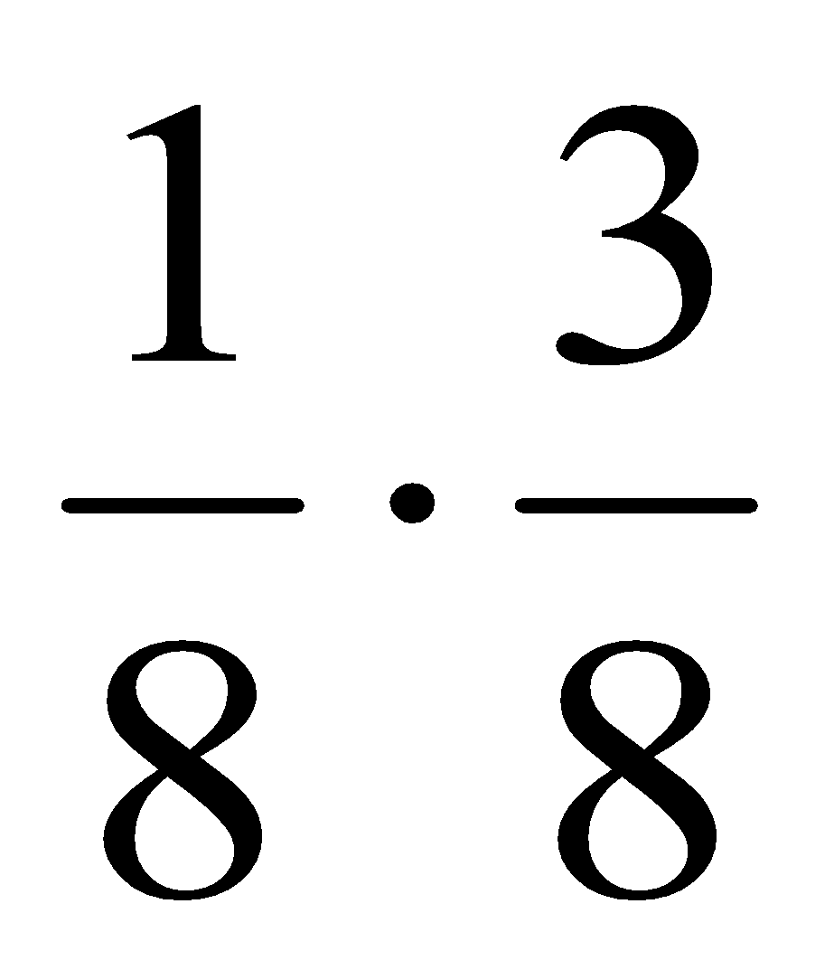
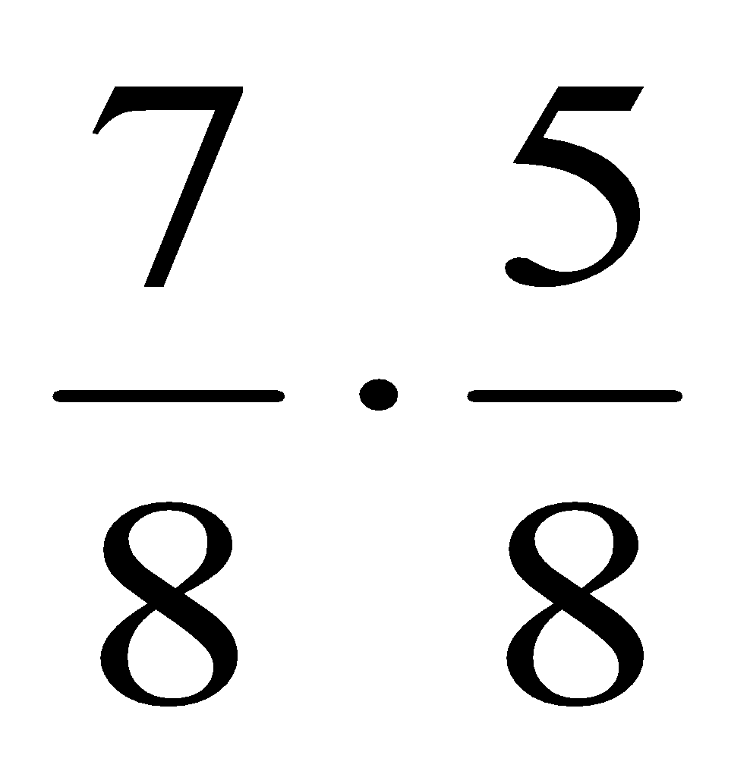
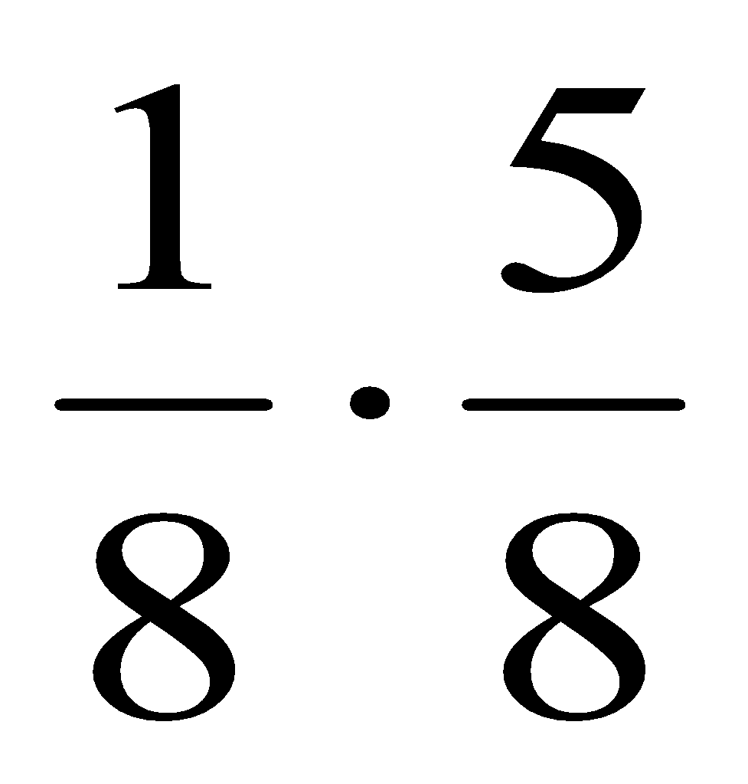
Joint estimation based on independence
Convert absolute frequencies to relative, dividing by the grand total
Fill the joint by the product of marginals
x₂
x₂
 | 1 | 2
1 | ? | ?
2 | ? | ?
 | 1 | 2
1
2
x₁
x₁
3/8
3/8
5/8
5/8
7/8
1/8
1
7/8
1/8
1

Slide 50
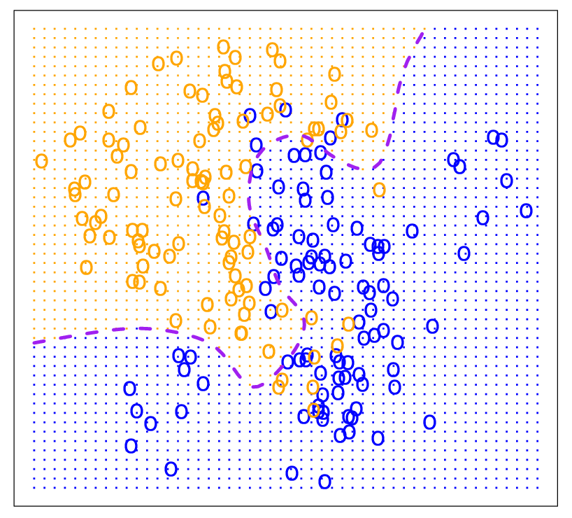
Bayes Optimal Classifier

Slide 51
Naive Bayes: The Basic Idea
For a given new record to be classified, find other records like it (i.e., same values for the predictors)
What is the prevalent class among those records?
Assign that class to your new record

Slide 52
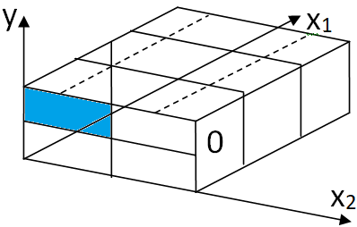
Naive Bayesian classifier
Naive Bayes classifier on Wiki
If we have many features, each taking on many values, our occurrence table will be sparse. This means, most of the cells will have zero frequency.
Having the direct estimated Bayes classifier will compare zeros in most of the cases.
That is why we better assume independence to estimate the probabilities.

Slide 53
Naive Bayesian classifier
Suppose, we have the following occurrence table for the first class
If combination for some value x_{i} of variable X, and some value y_{i} of variable Y, the combination (x_{i}, y_{i}) did not occur in the training set, but it is expected in the testing set, it is recommended to add a very small frequency of this value, taking away from the other values.
x₁
 | 2 | 3 | 1
1 |  |  |  | 3
2 |  |  |  | 3
 | 2 | 3 | 1 | 6
x₂
Class Y=1

Slide 54
Naive Bayesian classifier
Compute joint conditional probabilities, assuming conditional independence
x₁
x₁
 | 1 | 2 | 3
1
2
 |  |  |  | 1
 | 1 | 2 | 3
1 |  |  |  | 2
2 |  |  |  | 6
 | 1 | 5 | 2 | 8
x₂
x₂
Class Y = 1
Class Y = 2

Slide 55
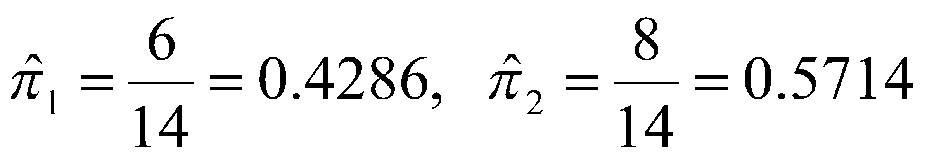

Naive Bayes classifier
The grand total = 6 + 8 = 14
Now we can estimate the prior distribution of class variable Y
Assuming conditional independence, the product table for the second class is
x₁
 | 1 | 2 | 3
1
2
 |  |  |  | 1
Class Y = 2
x₂

Slide 56
Usage
Requires categorical variables
Numerical variable must be binned and converted to categorical
Can be used with very large data sets
Example: Spell check programs assign your misspelled word to an established “class” (i.e., correctly spelled word)

Slide 57
Solution – Naive Bayes
Assume independence of predictor variables (within each class)
Use multiplication rule
Find same probability that record belongs to class C, given predictor values, without limiting calculation to records that share all those same values

Slide 58
Calculation
Take a record, and note its predictor values
Find the probabilities those predictor values occur across all records in C1
Multiply them together, then by proportion of records belonging to C1
Same for C2, C3, etc.
Prob. of belonging to C1 is value from step (3) divide by sum of all such values C1 … Cn
Establish & adjust a “cutoff” prob. for class of interest

Slide 59
Example: Financial Fraud
Target variable: Audit finds fraud, no fraud
Predictors:
Prior pending legal charges (yes/no)
Size of firm (small/large)

Slide 60
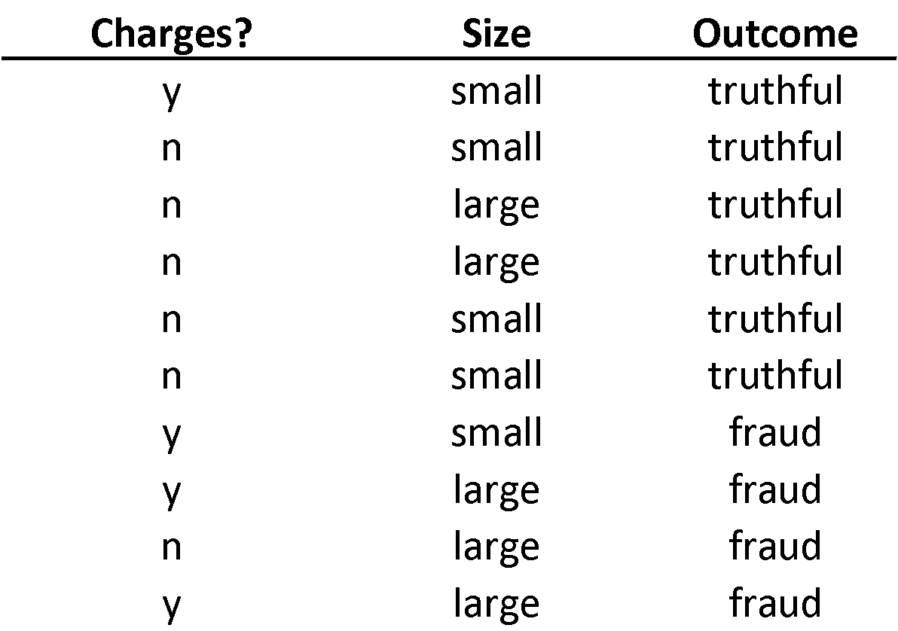

Slide 61
Exact Bayes Calculations
Goal: classify (as “fraudulent” or as “truthful”) a small firm with charges filed
There are 2 firms like that, one fraudulent and the other truthful
P(fraud | charges=y, size=small) = ½ = 0.50
Note: calculation is limited to the two firms matching those characteristics

Slide 62
Naïve Bayes Calculations
Compute 2 quantities:
Proportion of “charges = y” among frauds, times proportion of “small” among frauds, times proportion frauds = 3/4 * 1/4 * 4/10 = 0.075
Prop “charges = y” among frauds, times prop. “small” among truthfuls, times prop. truthfuls = 1/6 * 4/6 * 6/10 = 0.067
P(fraud | charges, small) = 0.075/(0.075+0.067)
= 0.53

Slide 63
Naïve Bayes, cont.
Note that probability estimate does not differ greatly from exact
All records are used in calculations, not just those matching predictor values
This makes calculations practical in most circumstances
Relies on assumption of independence between predictor variables within each class

Slide 64
Independence Assumption
Not strictly justified (variables often correlated with one another)
Often “good enough” – ranking of probabilities is more important than unbiased estimate of actual probabilities

Slide 65
Example - Flight Delays
Predictors
Day of Week Coded as 1 = Monday, 2 = Tuesday, ..., 7 = Sunday
Sch. Dep. Time Broken down into 18 intervals between 6:00 AM and 10:00 PM
Origin Three airport codes: DCA (Reagan National), IAD (Dulles),
BWI (Baltimore–Washington Int’l)
Destination Three airport codes: JFK (Kennedy), LGA (LaGuardia),
EWR (Newark)
Carrier Eight airline codes: CO (Continental), DH (Atlantic Coast),
DL (Delta), MQ (American Eagle), OH (Comair),
RU (Continental Express), UA (United), and US (USAirways)

Slide 66
Data Prep
delays_df = pd.read_csv('FlightDelays.csv')
# convert to categorical
delays_df.DAY_WEEK = delays_df.DAY_WEEK.astype('category')
delays_df['Flight Status'] = delays_df['Flight Status'].astype('category')
# create hourly bins departure time
delays_df.CRS_DEP_TIME = [round(t / 100) for t in delays_df.CRS_DEP_TIME]
delays_df.CRS_DEP_TIME = delays_df.CRS_DEP_TIME.astype('category')
predictors = ['DAY_WEEK', 'CRS_DEP_TIME', 'ORIGIN', 'DEST',
'CARRIER']
outcome = 'Flight Status'

Slide 67
Dummies and Partitioning
X = pd.get_dummies(delays_df[predictors])
y = delays_df['Flight Status'].astype('category')
classes = list(y.cat.categories)
# split into training and validation
X_train, X_valid, y_train, y_valid = train_test_split(X, y,
test_size=0.40, random_state=1)

Slide 68
Run Naive Bayes
# run naive Bayes
delays_nb = MultinomialNB(alpha=0.01)
delays_nb.fit(X_train, y_train)
# predict probabilities
predProb_train = delays_nb.predict_proba(X_train)
predProb_valid = delays_nb.predict_proba(X_valid)
# predict class membership
y_valid_pred = delays_nb.predict(X_valid)

Slide 69
Advantages
Handles purely categorical data well
Works well with very large data sets
Simple & computationally efficient

Slide 70
Shortcomings
Requires large number of records
Problematic when a predictor category is not present in training data
Assigns 0 probability of response, ignoring information in other variables

Slide 71

Classification metrics quiz practice
Consider a contrived problem of assigning a class $Y∈ \{0, 1\},$based on two predictors $X_{1}∈ \{0, 1\}$and $X_{2} ∈ \{0, 1\}$. So we have a hypothesis space of functions $f: {\left\{0, 1\right\}}^{2}→ \{0, 1\}.$
https://www.geeksforgeeks.org/ml-understanding-hypothesis/
Q1. How many functions are contained in this hypothesis space?
Hint: The number of functions $f: A→ B$ is $b^{a}$, where a is a number of elements in A and b is a number of elements in B.

Slide 72

Classification metrics quiz practice
Q2. Consider a specific classifier $\hat{y}(x)$:
Also, consider a testing dataset
Compute the predicted classes for this data, thus creating and filling the last $\hat{y}$column.
# | x1 | x2 | yHat
1 | 0 | 0 | 1
2 | 0 | 1 | 0
3 | 1 | 0 | 1
4 | 1 | 1 | 0
# | x1 | x2
1 | 0 | 0
2 | 0 | 0
3 | 1 | 0
4 | 0 | 0
5 | 1 | 1
6 | 1 | 1

Slide 73

Classification metrics quiz practice
Q3. Now the true classes of our dataset become known. Thus, we have the new y column:
Traditionally, consider 0 to be a negative class, while 1 be a positive class. Putting together your y and $\hat{y}$ columns, label each line and TP, TN, FP, FN in a new column that you call label.
# | x1 | x2 | y
1 | 0 | 0 | 1
2 | 0 | 0 | 1
3 | 1 | 0 | 0
4 | 0 | 0 | 1
5 | 1 | 1 | 1
6 | 1 | 1 | 1

Slide 74
Classification metrics quiz practice
Q4. The label column in the previous question may be considered as data for the confusion matrix in a tall format. Now, count the labels and put them into a new format, thus creating the actual confusion matrix.
Q5. Compute the margins of the table in the previous questions, thus computing
(Condition N) = (N) = (number of actual Y=0) = (TN + FP)
(Condition P) = (P) = (number of actual Y=1) = (FN + TP)
(Predicted N) = (number of predicted Y=0) = (TN + FN)
(Predicted P) = (number of predicted Y=1) = (FP + TP)

Slide 75
Classification metrics quiz practice
Q6. Compute sensitivity (recall, hit rate or true positive rate TPR) =TP/P
Q7. In this case frequencies of both classes are quite similar. Comment on applicability of the metric in the previous question in case when one class is much more frequent than the other.
Q8. Compute specificity (selectivity or true negative rate TNR) = TN/N
Note, this metric is not implemented in sklearn.
Q9. Compute precision (or positive predictive value PPV) = TP/(TP+FP
Q10. Compute accuracy = (TP+TN)/(P+N)
Q11. Compute F1-score as a harmonic mean of precision and recall:
2 * PPV * TPR / (PPV + TPR) = 2 * TP / (2*TP + FP + FN)

Slide 76

Classification metrics quiz practice
Q12. In Python, consider classification report, corresponding to this example. Some of these metrics we already computed. The other parts of it we will compute now step by step.
If initially we computed precision with default class to be positive, now, according to above classification report, we need to compute class-wise precision:
precision(0) = (or negative predictive value NPV)
precision(1) (or positive predictive value PPV)

Slide 77
Classification metrics quiz practice
Q13. In the previous question, we computed class-wise precision values. The Python classification report contains its macro average = (precision(0) + precision(1))/2 =
Q14. As you could see, the classification report contains the rightmost support column. It contains absolute prior frequencies of classes. Compute
support_0 = number of points that actually belong to class 0 = ?
support_1 = number of points that actually belong to class 1 =?
Q15. Compute the full support = support_0 + support_1
Q16. Compute class prior relative frequencies that will be used as weights for further averaging.
weight_0 = support_0 / support
weight_1 = support_1 / support
Q17. Check weight_0 + weight_1 =

Slide 78
Classification metrics quiz practice
Q18. The bottom row of the classification report contains weighted averages of the metrics. They use the weights that you computed in the previous questions. Compute the weighted precision = weight_0 * precision_0 + weight_1 * precision_1=?
Q19. In the previous questions, you computed recall in its default sense as sensitivity, hit rate or true positive rate TPR =TP/P. Now we call that quantity recall_1, and we also need recall_0. Please, write both:
recall_0 = TN/N = ?
recall_1 = TP/P = ?
Q20. In the previous question you computed two class-wise recalls. Now compute their arithmetic mean, called macro average in Python's classification report
macro avg recall = (recall_0 + recall_1) / 2=?

Slide 79
Classification metrics quiz practice
Q21. In the previous questions, you computed two classwise recalls, and also class weights or priors. Use them to compute the weighted average recall = weight_0 * recall_0 + weight_1 * recall_1=?
Q22. In the previous questions, you computed f1-score as a harmonic mean of precision and recall. Now we say, it was a default f1-score with respect to class 1, and we also want its class 0 counterpart. Write both
f1_0 = H(precision_0, recall_0) = ?
f1_1 = H(precision_1, recall_1) = ?
Note: the formula
H(x1, x2) = 2*x1*x2 /(x1 + x2)
does not work if both components are 0. In this case, use H(0, 0) = 0.

Slide 80
Classification metrics quiz practice
Q23. In the previous question, you computed two classwise f1 scores. Now compute their arithmetic mean, called macro average in Python's classification report:
macro avg f1 = (f1_0 + f1_1) / 2 = ?
Q24. In the previous questions, you computed two classwise f1 scores and also class weights. Now compute f1 weighted average, listed in the botton line of Python's classification report:
weighted avg f1 = w_0*f1_0 + w_1*f1_1 = ?

Slide 81

Quiz practice. Confusion matrix questions
Suppose you built a model for solving a classification problem and got the result in the form of a confusion matrix
Now, your boss asks you three questions:
What percent of your predictions were correct?
What percent of the positive cases did you catch?
What percent of positive predictions were correct?

Slide 82
Classification metrics quiz. FP & FN
False positive also named as …
type I errors
α errors
type II errors
β errors
False negative also named as …
type I errors
α errors
type II errors
β errors

Slide 83
Classification metrics quiz. Accuracy advantages
Advantages of “accuracy” metric:
Useless on unbalanced sets
Useful on unbalanced sets
Easy to interpret
Simple calculation principle

Slide 84
Classification metrics quiz. Accuracy disadvantages
Disadvantages of “accuracy” metric:
Useless on unbalanced sets
Hard to interpret
Complex calculation principle

Slide 85
Classification metrics quiz. Python
Which function can we use to get precision, recall, f1-score and accuracy metrics?
sklearn.metrics.describe()
sklearn.metrics.classification_report()
sklearn.metrics.metrics()
sklearn.metrics.results()

Slide 86
Classification metrics quiz practice. Interpretation
Interpret precision metric and write it formula
Interpret recall metric and write it formula

Slide 87
Bayes classifier quiz practice 1
Q1. Suppose, we have the following data
This data has just classes $Y∈ \{1, 2\},$but no predictors X.
Note, {1, 2} are class labels, and they are not counts.
Estimate the prior probabilities of the classes
$${\hat{π}}_{1}=$$
$${\hat{π}}_{2}=$$
# | Y
1 | 1
2 | 2
3 | 1
4 | 1
5 | 2

Slide 88
Bayes classifier quiz practice 1
Q2. If new point y comes in, and we do not know its value, what is our best bet to classify it?
$\hat{Y}$= 1
$\hat{Y}$= 2

Slide 89


Bayes classifier quiz practice 1
Q3.
Now, suppose, we obtained more information about our 5 training points, thus having two predictor columns $X_{1}$ and $X_{2}$. This allows us to compose the following tall format table. We need to convert it to a wide format. Which one is right?
# | $$X_{1}$$ | $$X_{2}$$ | $$Y$$
1 | 1 | 1 | 1
2 | 2 | 2 | 1
3 | 2 | 2 | 1
4 | 1 | 2 | 2
5 | 2 | 2 | 2

Slide 90

Bayes classifier quiz practice 1
Q4. If we have new point X= (2, 2), how do we intuitively classify it?
$\hat{Y} (2, 2) = 1$
$\hat{Y} (2, 2) = 2$
Q5. If we have a new point X = (2, 1), what methods can we apply for its classification?
Exact Bayesian classifier.
Naive Bayesian classifier.
Both
Neither

Slide 91

Bayes classifier quiz practice 1
Q6. Estimate the joint probabilities
$P(X_{1}, X_{2} | Y=1),$conditioned on class Y.
A B
$X_{2}$ $$X_{1}$$ | 1 | 2
1 | 1/3 | 0
2 | 0 | 2/3
$X_{2}$ $$X_{1}$$ | 1 | 2
1 | 0 | 2/3
2 | 1/3 | 0

Slide 92
Bayes classifier quiz practice 1
Q7. Estimate the marginal probabilities $P(X_{1} | Y=1)$
$P\left(X_{1}=1 | Y=1\right)=\frac{1}{3} , P\left(X_{1}=2 | Y=1\right)=\frac{2}{3}$
$P\left(X_{1}=1 | Y=1\right)=\frac{2}{3} , P\left(X_{1}=2 | Y=1\right)=\frac{1}{3}$
Q8. Estimate the marginal probabilities $P(X_{2} | Y=1)$
$P\left(X_{2}=1 | Y=1\right)=\frac{1}{3} , P\left(X_{2}=2 | Y=1\right)=\frac{2}{3}$
$P\left(X_{2}=1 | Y=1\right)=\frac{2}{3} , P\left(X_{2}=2 | Y=1\right)=\frac{1}{3}$

Slide 93

Bayes classifier quiz practice 1
Q9. Estimate the joint probabilities $P(X_{1}, X_{2} | Y=2),$conditioned on class Y.
A B
$X_{2}$ $$X_{1}$$ | 1 | 2
1 | 0 | 1
2 | 0 | 1
$X_{2}$ $$X_{1}$$ | 1 | 2
1 | 0 | 1/2
2 | 0 | 1/2

Slide 94

Bayes classifier quiz practice 1
Q10. Estimate the marginal probabilities $P(X_{1} | Y=2)$
$P\left(X_{2}=1 | Y=1\right)=\frac{1}{2} , P\left(X_{2}=2 | Y=1\right)=\frac{1}{2}$
$P\left(X_{2}=1 | Y=1\right)=0 , P\left(X_{2}=2 | Y=1\right)=1$
Q11. Estimate the marginal probabilities $P(X_{2} | Y=2)$
$P\left(X_{2}=1 | Y=1\right)=\frac{1}{2} , P\left(X_{2}=2 | Y=1\right)=\frac{1}{2}$
$P\left(X_{2}=1 | Y=1\right)=0 , P\left(X_{2}=2 | Y=1\right)=1$

Slide 95
Bayes classifier quiz practice 1
Q12.
Assuming independence of $X_{1}, X_{2}$under condition of class Y, produce the joint distribution table of predictors in the first class:
$$P( X_{1}, X_{2}|Y=1) = P(X_{1}|Y=1) P(X_{2}|Y=1)$$
A B
$X_{2}$ $$X_{1}$$ | 1 | 2
1 | 2/9 | 3/9
2 | 3/9 | 4/9
$X_{2}$ $$X_{1}$$ | 1 | 2
1 | 1/9 | 2/9
2 | 2/9 | 4/9

Slide 96

Bayes classifier quiz practice 1
Q13.
Assuming independence of $X_{1}, X_{2}$under condition of class Y, produce the joint distribution table of predictors in the second class:
$$P( X_{1}, X_{2}|Y=2) = P(X_{1}|Y=2) P(X_{2}|Y=2)$$
A B
$X_{2}$ $$X_{1}$$ | 1 | 2
1 | 0 | 1/2
2 | 1/2 | 0
$X_{2}$ $$X_{1}$$ | 1 | 2
1 | 0 | 1/2
2 | 0 | 1/2

Slide 97

Bayes classifier quiz practice 1
Q14.
Using your estimate of joint distribution in questions 6 and 9, classify newly-arriving observation $(X_{1}=1, X_{2}=2)$, by the exact Bayes classifier
Q15.
Using your estimate of joint distribution in questions 12 and 13, classify newly-arriving observation $(X_{1}=1, X_{2}=2)$, by the Naive Bayes classifier

Slide 98


Bayes classifier quiz practice 1
Q16.
The code above prints the marginal probabilities. What code precedes it?
A. clf = CategoricalNB(alpha=0); clf.fit(y, x)
B. clf = CategoricalNB(alpha=0); clf.fit(x, y)
C. clf.fit(x, y); clf = CategoricalNB(alpha=0)
D. clf.fit(y, x); clf = CategoricalNB(alpha=0)

Slide 99

Bayes classifier quiz practice 2. Problem setting
Using this data, choose the right answer for the following 4 questions

Slide 100



Bayes classifier quiz practice 2. Question 1
a.
b.

Slide 101



Bayes classifier quiz practice 2. Question 2

Slide 102

Bayes classifier quiz practice 2. Question 3
X₁
X₁
 | 0 | 1 | 2
0 | 0.16 | 0.16 | 0.08
1 | 0.24 | 0.24 | 0.12
 | 0 | 1 | 2
0 | 0.24 | 0.08 | 0.08
1 | 0.36 | 0.12 | 0.12
X₂
X₂
a
b

Slide 103



Bayes classifier quiz practice 2. Question 4

Slide 104
Bayes classifier quiz practice 2. Question 5
Which module contains constructors of different naive Bayesian classifiers?
sklearn.naive_bayes
sklearn.NB
sklearn.bayesian_algorithms
sklearn

Slide 105
Bayes classifier quiz practice 2. Question 6
Which type should X and y arguments have to be submitted to fit() method of MultinomialNB object?
Array-like
Dataframe
Series
Dictionary

